Slide 1
IF I ONLY HAD A BRAIN THE MICROCONTROLLER
“IT LIVES!!!!”

Slide 2
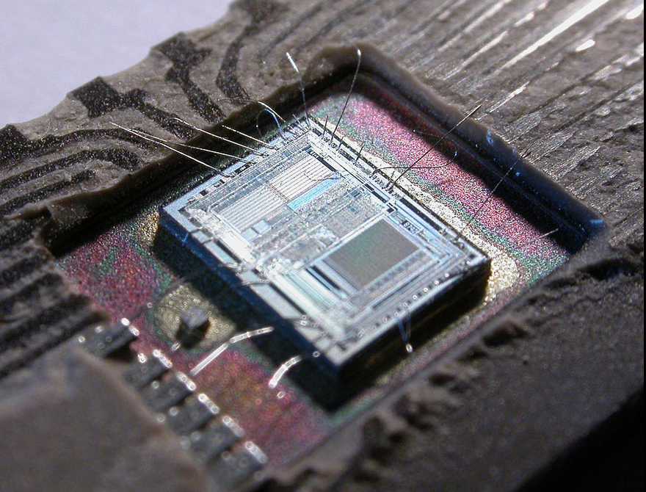
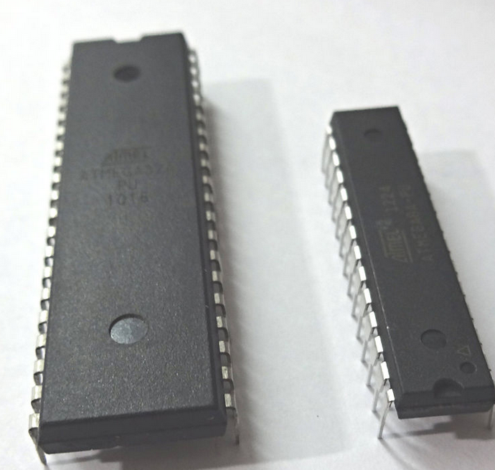
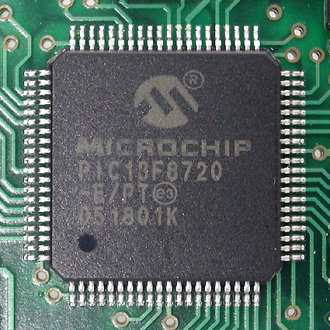
What are microcontrollers?
A microcontroller
(sometimes abbreviated µC, uC or MCU) is a small computer on a single integrated circuit containing a processor core, memory, and programmable input/output peripherals.

Slide 3

History
Notes:
Lets take a dive into the history of microcontrollers. They’ve certainly evolved over time.

Slide 4
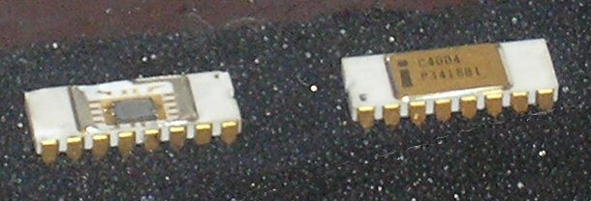
The first microprocessor
the 4-bit Intel 4004 released in 1971
Maximum clock rate of 740 kHz
8 clock cycles per instruction cycle
Notes:
It was the first commercially available microprocessor by Intel. It had a Maximum clock rate of 740 kHz
It’s Instruction cycle time was 10.8 µs^{[15]} or 8 clock cycles per instruction cycle. This thing was damn slow in comparison to our today’s processors.

Slide 5
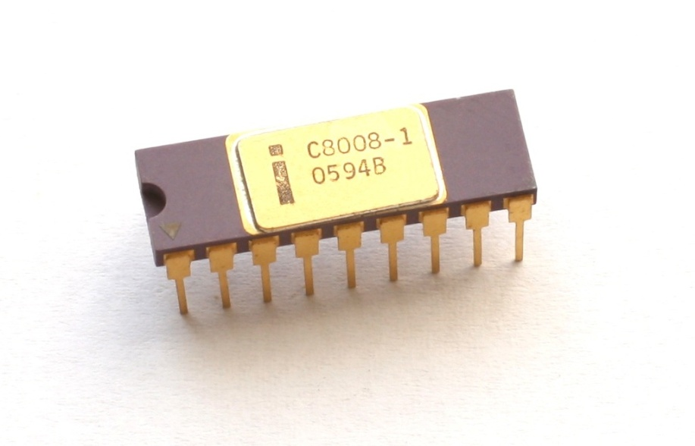
Intel 8008
Over time microprocessors became more advanced and available over the next several years
Maximum clock rate of 0.8 MHz
2 clock cycles per instruction cycle
Notes:
initial versions of the 8008 could work at clock frequencies up to 0.5 MHz
this was later increased in the 8008-1 to a specified maximum of 0.8 MHz
It’s Instruction cycle time was 20 μs^{[15]} or 2 clock cycles per instruction cycle. Now we’re getting a little faster.

Slide 6
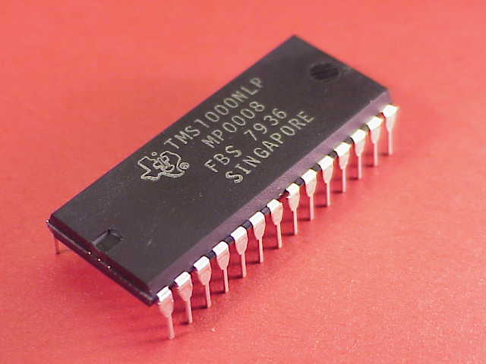
The First True Microcontroller
in 1971, TI engineers Gary Boone and Michael Cochran succeeded in creating the first microcontroller
This chip combined RAM and ROM on the same chip. This was a big deal.
Notes:
This chip combined RAM and ROM on the same chip. This was a big deal.

Slide 7

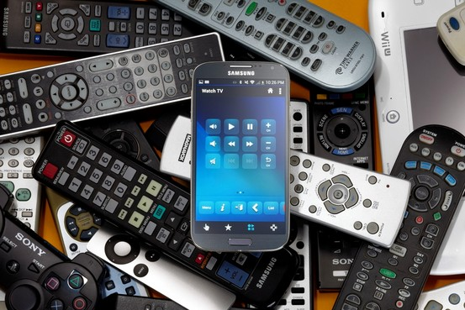
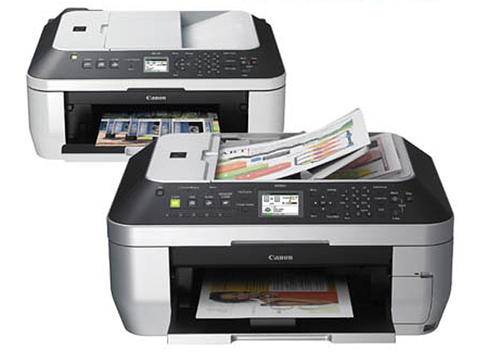
Where can I find them?
Notes:
Microcontrollers are used in automatically controlled products and devices, such as automobile engine control systems, implantable medical devices, remote controls, office machines, appliances, power tools, toys and other embedded systems.
So that ingenius device in your pocket that you use for flappy bird is a microcontroller in and of itself.

Slide 8
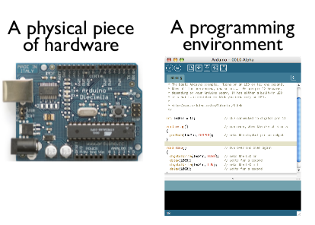
What is an Arduino?
Arduino is a microcontroller
open-source
easy-to-use
intended for making interactive projects
Notes:
Arduino is a microcontroller
Arduino is an open-source electronics platform based on easy-to-use hardware and software. It's intended for anyone making interactive projects

Slide 9
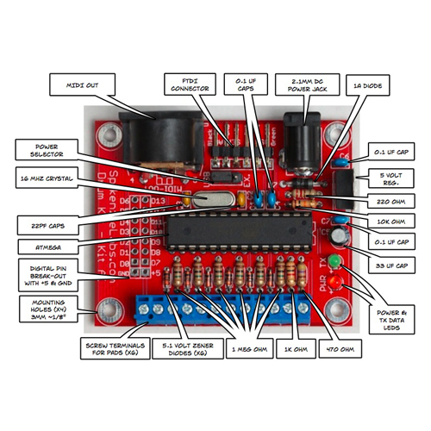
Another look
the chip is all that’s needed
create a lot from one chip
Notes:
Another look at what we can build.
In this case this is an Arduino board built for a drum kit.
Because the chip is all that’s needed, we can create a lot of hobby boards that can be used for something else.

Slide 10
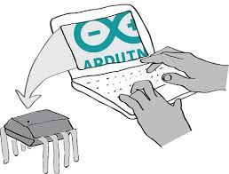
Programming
Typically programs must fit in the available on-chip program memory
Compilers and assemblers convert high-level language to a compact machine code
Notes:
Typically microcontroller programs must fit in the available on-chip program memory, since it would be costly to provide a system with external, expandable, memory. Compilers and assemblers are used to convert high-level language and assembler language codes into a compact machine code for storage in the microcontroller's memory.

Slide 11
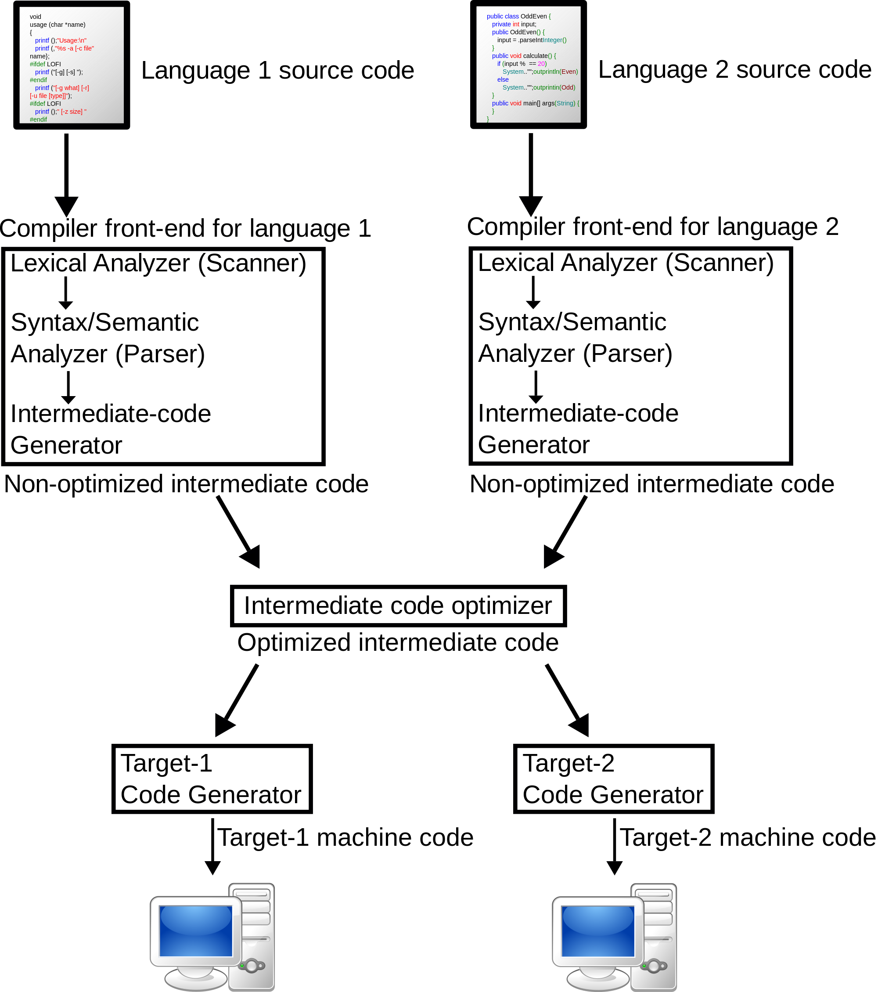
Compilers
transforms source code
Often into binary
Notes:
A compiler is a computer program (or set of programs) that transforms source code written in a programming language (the source language) into another computer language (the target language, often having a binary form known as object code)

Slide 12
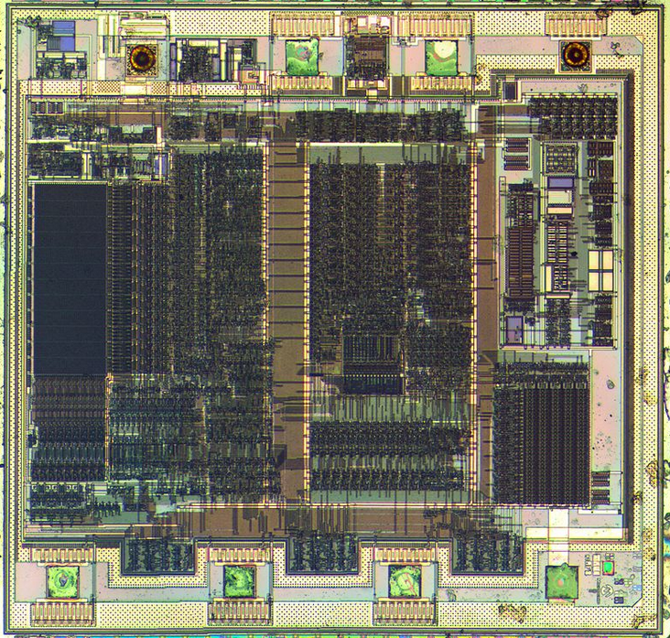
Embedded Systems
read sensors that produce analog signals
ADC converts incoming data that a processor can recognize
Notes:
Many embedded systems need to read sensors that produce analog signals. This is the purpose of the analog-to-digital converter (ADC). Since processors are built to interpret and process digital data, i.e. 1s and 0s, they are not able to do anything with the analog signals that may be sent to it by a device. So the analog to digital converter is used to convert the incoming data into a form that the processor can recognize. A less common feature on some microcontrollers is a digital-to-analog converter (DAC) that allows the processor to output analog signals or voltage levels.

Slide 13
How Popular are these things
In 2002, about 55% of all CPUs sold in the world were 8-bit microcontrollers and microprocessors
two billion 8-bit microcontrollers were sold in 1997
according to Semico, over four billion 8-bit microcontrollers were sold in 2006
Semico has claimed the MCU market grew 36.5% in 2010 and 12% in 2011
Yeah this little monolithic chips are pretty popular

Slide 14
What’s the point?
AUTOMATION
Notes:
Making our lives easier

